Slide 1
FIND THE CENTRAL TENDENCY
800, 1200, 1500, 1200, 1800, 2000, 1200
Which value best represents customer spending?
Why?

Slide 2
WHY ISN'T AVERAGE ENOUGH?
Consider the following two datasets:
Dataset A
40, 40, 40, 40, 40
Mean = 40
Dataset B
10, 20, 40, 60, 70
Mean = 40
Observation
Although both datasets have the same mean, they are very different.
Dataset A has values close to each other.
Dataset B has values spread far apart.
Conclusion
To understand the spread or variability of data, we use Measures of Dispersion

Slide 3
WHAT ARE MEASURES OF DISPERSION?
Definition
Measures of dispersion describe how far the data values are spread around the central value.
They indicate the consistency or variability within a dataset.
Business Examples
Variation in employee salaries
Variation in daily sales
Stock price fluctuations
Customer spending patterns
Importance
Measures data variability
Compares consistency between datasets
Detects outliers
Supports better business decisions
Improves risk analysis

Slide 4
TYPES OF MEASURES OF DISPERSION
1. Range - Difference between the highest and lowest value.
2. Variance - The squared Standard Deviation.
3. Standard Deviation - How far values stray from the mean.
4. IQR (Interquartile Range) - Spread of the middle half (Q3 - Q1).

Slide 5
RANGE
The range is the difference between the maximum and minimum values in a dataset.
Formula
Range = Maximum Value − Minimum ValueRange
Dataset:
15, 20, 25, 30, 40
Maximum = 40
Minimum = 15
Range = 40 – 15 = 25
Advantages
Very easy to calculate
Gives a quick idea of data spread
Limitations
Uses only two values
Strongly affected by outliers

Slide 6
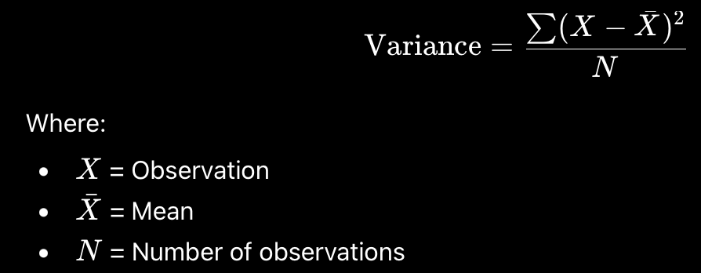
VARIANCE
Variance measures the average squared deviation of each observation from the mean.
It indicates how much the data varies.
Formula:
Example
Dataset: 4, 5, 6
Variance = 0.67
A larger variance indicates greater variability.

Slide 7

STANDARD DEVIATION
Example
Variance = 16
Standard Deviation = √16 = 4
Interpretation
Low standard deviation → Data values are close to the mean.
High standard deviation → Data values are widely spread.
Business Applications
Financial risk analysis
Stock market volatility
Sales performance analysis
Quality control in manufacturing
Standard deviation is the square root of the variance.
It is the most widely used measure of dispersion because it is expressed in the same unit as the data.
Formula

Slide 8
VARIANCE VS STANDARD DEVIATION
Feature | Variance | Standard Deviation
Definition | Average squared deviation from the mean | Square root of variance
Unit | Squared units | Same as original data
Ease of Interpretation | More difficult | Easier
Mathematical Use | Statistical calculations | Data interpretation
Common Business Use | Model development | Performance comparison

Slide 9
Interquartile Range (IQR)
Represents the spread of the middle 50% of the data. It is calculated as the difference between the third quartile (Q3)and the first quartile (Q1).
IQR = (Q3 - Q1)
Where:
Q1 (First Quartile): 25% of the observations lie below this value.
Q2 (Second Quartile): Median (50th percentile).
Q3 (Third Quartile): 75% of the observations lie below this value.
Why is IQR Important?
Measures the spread of the central 50% of the data.
Less affected by extreme values (outliers).
Useful for comparing the variability of different datasets.
Commonly used in Box Plots to detect outliers.
Business Applications
Product prices
Financial and sales data with extreme values
IQR provides a more reliable measure of data spread when outliers are present

Slide 10
Interquartile Range (IQR)
Consider the following dataset representing the daily number of products sold:
5, 7, 8, 10, 12, 15, 18, 20, 22
Arrange the data in ascending order
Find the median, Q2 = 12
Find, Q1 = (7 + 8) / 2 = 7.5
Find, Q3 = (18 + 20) / 2 = 19
IQR = Q3 - Q1 = 11.5
Ques: Find IQR of: 28, 15, 35, 18, 20, 22, 12, 25, 30

Slide 11
BUSINESS CASE STUDY – COMPARING TWO COMPANIES
Company | Mean Sales (₹) | Standard Deviation
Company A | 50,000 | 2,000
Company B | 50,000 | 12,000
Two companies have the same average monthly sales.
Interpretation
Company A
Sales are consistent.
Low variation.
More predictable performance.
Company B
Sales fluctuate significantly.
High variation.
Less predictable performance.
Conclusion
Even though both companies have the same average sales, Company A demonstrates greater stability because of its lower standard deviation.

Slide 12
THANK YOU

